Slide 1
TODO
Add facet/filtering
Add free text search

Slide 2
Test driving Azure Search and DocumentDB
Andrew Siemer | Clear Measure
andrew@clear-measure.com
@asiemer

Slide 3







Andrew Siemer
http://about.me/andrewsiemer
ASP Insider
MS v-TSP (Azure)
Azure Advisor Program
Father of 6. Jack of all trades, master of some.
Notes:
Andrew Siemer, I am an ASP Insider, Microsoft virtual technology specialist program, father of 6, and general jack of all trades – master of some!
I enjoy all things texas, obstacle racing, cowboying, and playing with my six kids

Slide 4

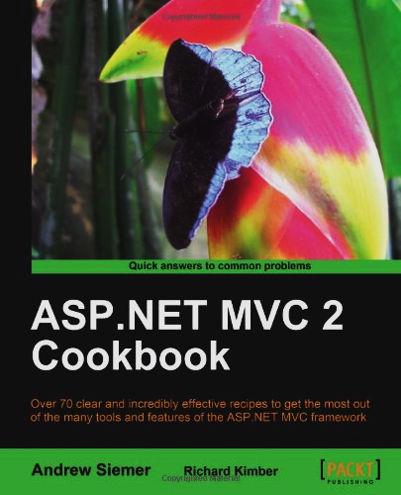


Notes:
Some books I have written or am writing

Slide 5

Writing a book on Azure
LeanPub
GitHub
Written in the open
Want to help?
Notes:
We are starting an Azure book. Written in the open on LeanPub and GitHub. Want to help?

Slide 6











← We are hiring!!!
Notes:
Some places I have worked and some projects I have worked on

Slide 7
Join us at AzureAustin
http://www.meetup.com/AzureAustin

Slide 8
Topics Today
DocumentDB
Azure Search
Where might you use each?

Slide 9
Caveats!
Both Azure Search and DocumentDB are in preview mode. All of this stuff changes often! A lot of my content was updated as of this morning…but I may have missed some bits.

Slide 10
Starting with a high level view

Slide 11

DocumentDB is a type of NoSQL

Slide 12

What is NoSQL?
Data is co-located with other data contextually
User/Profile
Timeline
Friends list
Filtering the results happens on the co-located data
Not by grouping out of bounds data
No joins across stores of data
Sub selections and reshaping the co-located data is ok
Reshaping data across boundaries is not supported

Slide 13
Many types of NoSQL
Document databases
Pairs a key with a complex shape of data
Graph stores
Stores data about networks such as social connections
Key-value stores
Simplest, a key maps to a value
Wide-column stores
Used for queries of large datasets

Slide 14
They all have something in common!
All the data for a given thing lives close

Slide 15
When is NoSQL better than N
Unstructured data
Favors data that is immediately related
Denormalized (or flat) data
Need easy scaling options – distributed by default (add nodes)
When you don’t need transactions across collections
Notes:
Unstructured, immediately related, denormalized, distributed by default, transactions across collections not required

Slide 16
When not to use NoSQL
Need to do heavy joins across collections
When many to many query depth is unknown
User has a collection of users (friends) which have a collection of users
Transactions across stores are important

Slide 17
Azure Search is Elastic Search is Lucene

Slide 18
What is search?
Indexes
Documents
Fields
Types of searchability
Retrievable
Non-retrievable
Tokenization
Facets
Scoring

Slide 19
When to use search
Need an easy way to score results
Fuzzy searching is easy
Finely control results around business rules
Ability to boost newer results
Built around distributed first (over SOLR, others)

Slide 20
When not to use search
Large computational work
Need real time data access
Small budget + high availability

Slide 21
Example application
https://github.com/asiemer/AzureJeeps

Slide 22


Example site: jeep listings
Listings contain:
A picture of a Jeep
Various jeep options
Dealer information
Price info

Slide 23
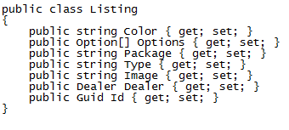
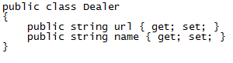
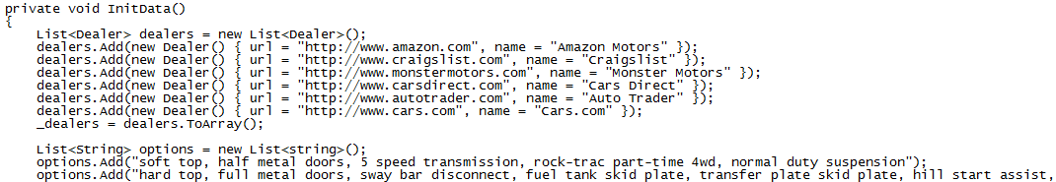
Example site: jeep listings

Slide 24
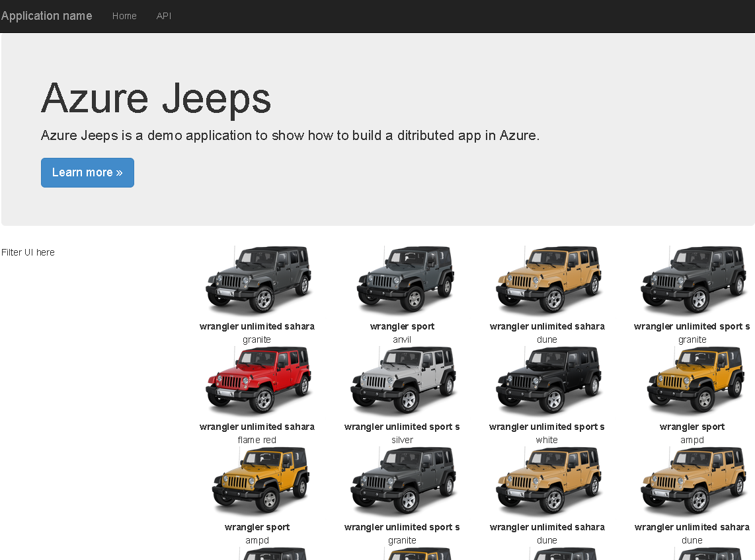

Slide 25
DocumentDB
Notes:
Let’s quickly look at how we can set up and configure a DocumentDB

Slide 26

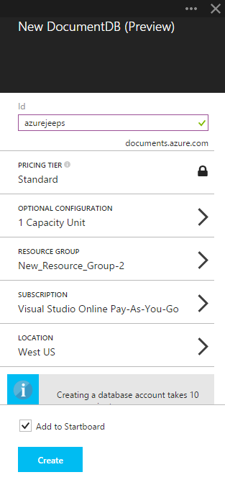
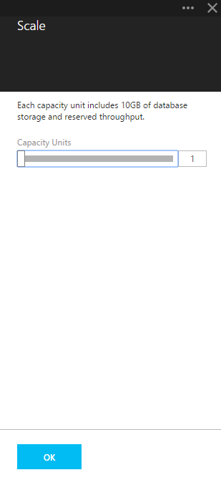
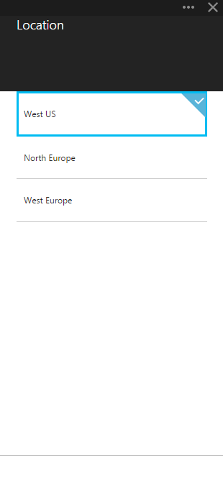
How to set up DocumentDB
Notes:
In case the internet is down, some screen shot quick steps for setting up a documentdb

Slide 27
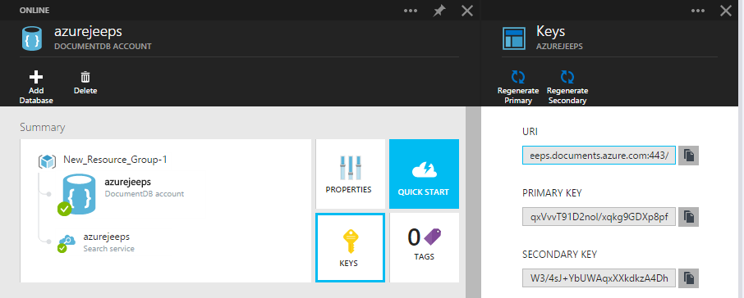
Keys

Slide 28
Document Explorer
Add documents from a file
Create a document on the web page directly
Edit documents on the web page directly

Slide 29
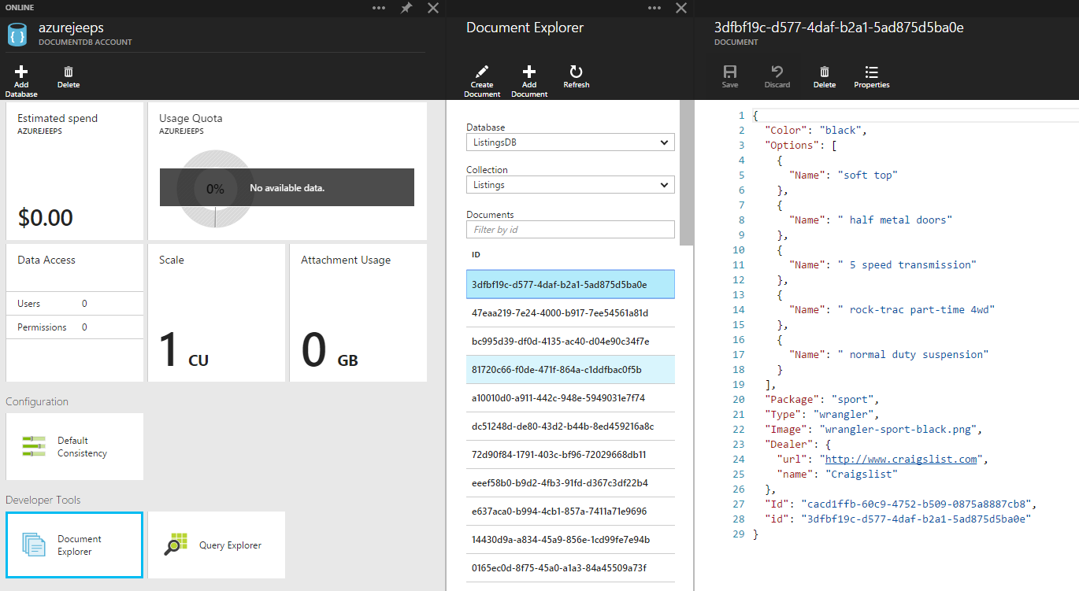

Slide 30
Query Explorer
Think “management studio” for document db

Slide 31
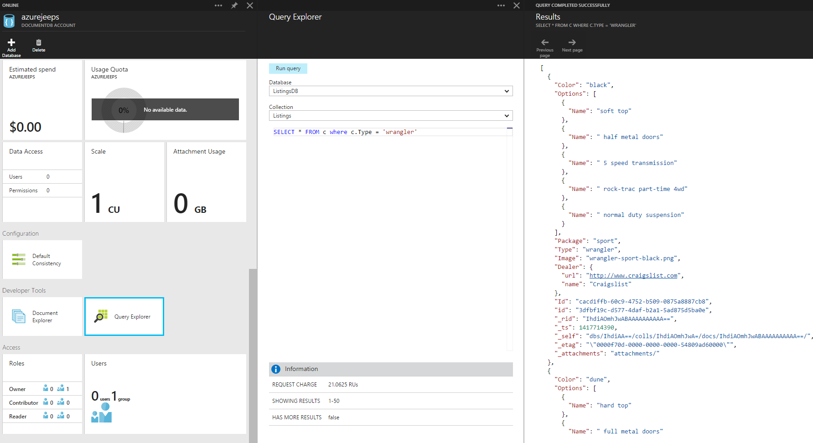

Slide 32
DocumentDB high points
Has a Microsoft provided SDK via Nuget
Uses auth key for security
Everything is based on a capacity unit
Up to 5 capacity units available for preview
10GB per capacity unit
2000 requests per second
$.73/day ($22.50 per month)
Average operations per second per capacity unit
Based on simple structure
2000 read of a single document
500 inserts, replaces, or deletes
1000 queries returning a single document
Notes:
All the marketing specs around DocumentDB. Everything is capacity unit based. Speed specs assume simple document structure.

Slide 33
Elastic SSD
Makes data store elastic and fast
Add/Remove documents grows/shrinks collection
Tested with real-world clients from gigabytes to terrabytes

Slide 34
Automatic Indexing
Indexing on by default
Can optimize for performance and storage tradeoffs
Index only specific paths in your document is more performant
Synchronous indexing at write time by default
Can be Asynchronous for boosted write performance
Eventually consistent

Slide 35
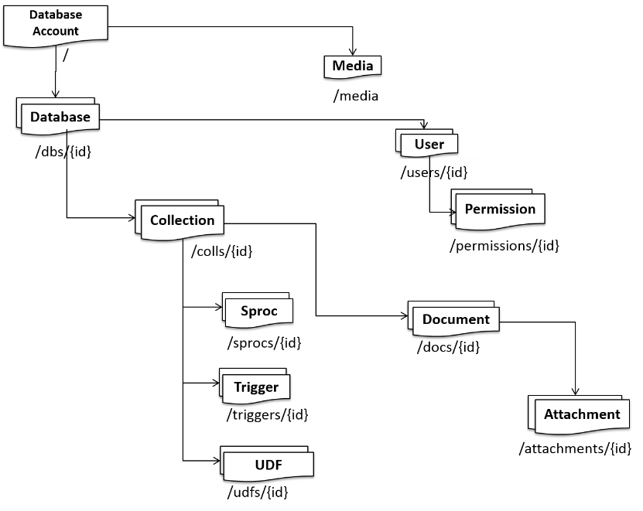
Understanding the DocumentDB structure
Notes:
http://azure.microsoft.com/en-us/documentation/articles/documentdb-interactions-with-resources/

Slide 36
Structure: Database
The container that houses your data
/db/{id} is not your ID
Hash known as a “Self Link”

Slide 37
Structure: Media
Video
Audio
Blob
Etc.

Slide 38
Structure: User
Invite in an existing azure account
Allows you to set permissions on each concept of the database

Slide 39
Structure: Permission
Authorization token
Associated with a user
Grants access to a given resource

Slide 40
Structure: Collection
Most like a “table”
Structure is not defined
Dynamic shapes based on what you put in it

Slide 41
Structure: Document
A blob of JSON representing your data
Can be a deeply nested shape
No specialty types
No specific encoding types

Slide 42
Structure: Attachment
Think media – at the document level!

Slide 43
Structure: Stored Procedure
Written in javascript!
Is transactional
Executed by the database engine
Can live in the store
Can be sent over the wire

Slide 44
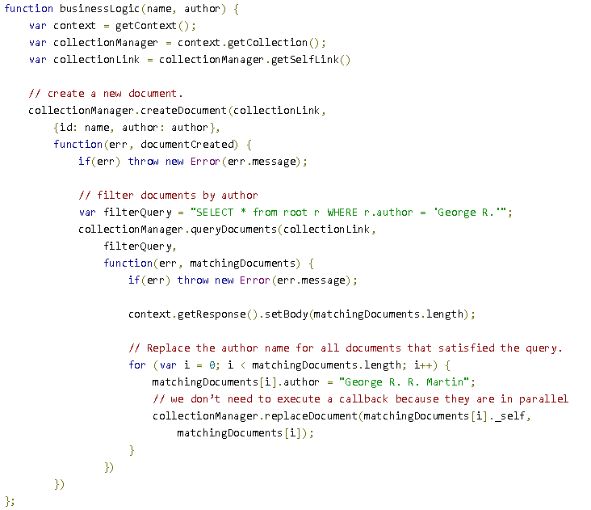

Slide 45
Structure: Triggers
Can be Pre or Post (before or after)
Can operate on the following actions
Create
Replace
Delete
All
Also written in javascript!

Slide 46
Structure: UDF
Can only be ran on a query
Modifies the result of a given query
mathSqrt()

Slide 47
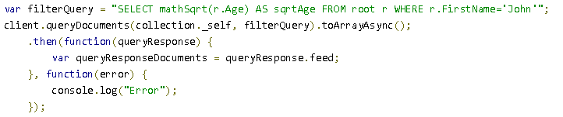

Slide 48
Create a document store
Everything is done asynchronously!
The ID of a new database is the friendly name
database = await GetClient().CreateDatabaseAsync(new Database { Id = id });

Slide 49
Adding data
Since DocumentDB is dynamic you just throw data in
await client.CreateDocumentAsync(documentCollection.SelfLink, listing);

Slide 50
Batch operations
Not necessarily a built in operation
Can be done with a stored procedure that takes a collection of documents (JSON)

Slide 51
Querying
Everything is done asynchronously in the SDK
The ID of a new database is the friendly name
Everything references the “SelfLink”
This is the internal ID of the resource you are working with
Used to build up the API call
http://azure.microsoft.com/en-us/documentation/articles/documentdb-sql-query/

Slide 52
Querying: Simple
SELECT * FROM
var client = GetClient();
var collection = await GetCollection(client, Keys.ListingsDbName,
Keys.ListingDbCollectionName);
string sql = String.Format("SELECT * FROM {0}", Keys.ListingDbCollectionName);
var jeepsQuery = client.CreateDocumentQuery<Listing>(collection.SelfLink,
sql).ToArray();
var jeeps = jeepsQuery.ToArray();

Slide 53
Querying: More complex
Joining requires the shape to be specified
var client = GetClient();
var collection = await GetCollection(client, Keys.ListingsDbName,
Keys.ListingDbCollectionName);
string sql = String.Format(@"SELECT l.Color, l.Options, l.Package, l.Type, l.Image,
l.Dealer, l.Id
FROM {0} l
JOIN o IN l.Options
WHERE o.Name = 'hard top'", Keys.ListingDbCollectionName);
var hardtopQuery = client.CreateDocumentQuery<Listing>(collection.SelfLink,
sql).ToArray();

Slide 54
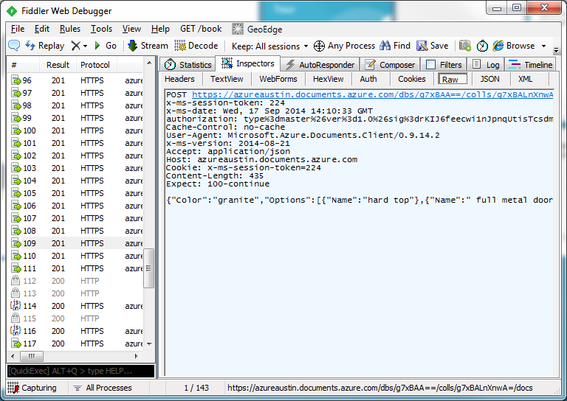
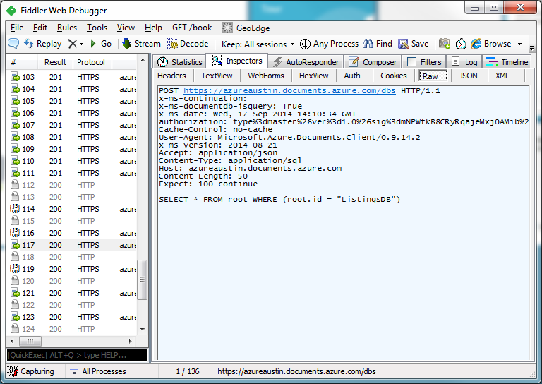
REST API
Everything is done via a REST call!
Create data request
Query data request

Slide 55
Interactive query demo online
Microsoft has provided an interactive demo for you to play with
http://www.documentdb.com/sql/demo

Slide 56
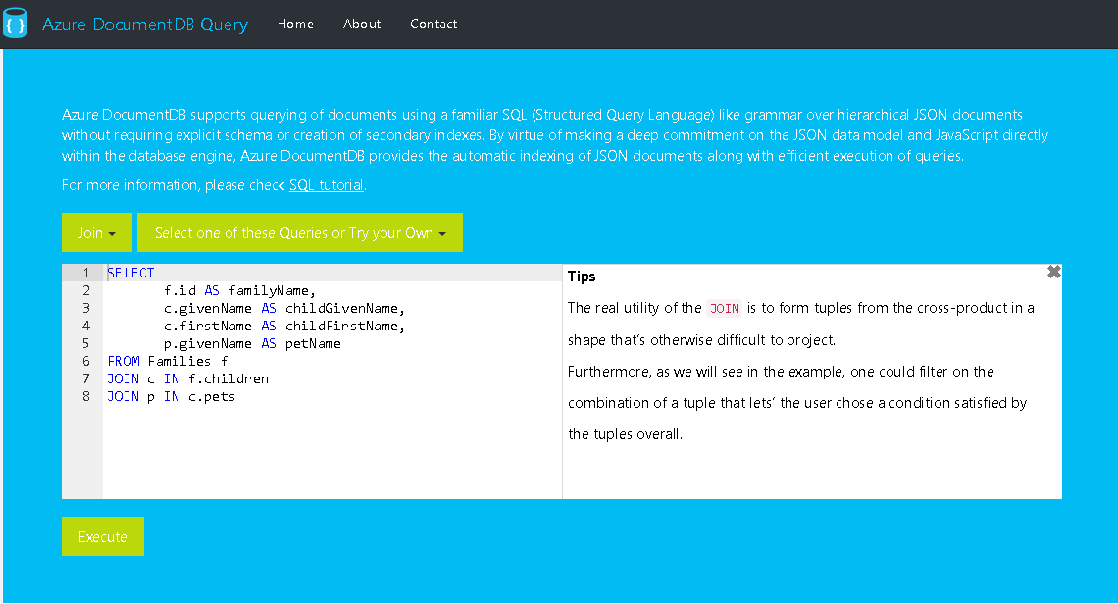

Slide 57
Questions on Document DB?

Slide 58
Azure Search

Slide 59

What is search?
You mean “where [field] like ‘%query%’” isn’t a search engine?
NOPE!!!!

Slide 60
What is search?
Indexes
Documents
Fields
Types of searchability
Retrievable
Non-retrievable
Tokenization
Facets
Scoring

Slide 61
What is Azure Search Preview?
Hosted
High performance
Horizontally scalable
Elastic Search under the covers

Slide 62
Concerns with the preview?
English only
No additional tokenization strategies
Standard: treats white space and punctuation as delimiters
Keyword: treats entire string as a token
Fixed fields (can’t remove)
No document level security

Slide 63
api-version=2014-10-20-Preview
Lots of language support!
Arabic
Brazilian
Chinese Simplified
Chinese Traditional
Czech
Danish
Dutch
German
Greek
English
Finnish
French
Hindi
Hungarian
Indonesian
Italian
Japanese
MANY MORE!!!
http://goo.gl/qF7OJ0

Slide 64
Setting up Azure Search

Slide 65
Setting up Azure Search
Name
“yourname”.search.windows.net
Pay attention to the naming rules
Pricing tier
Resource group
A collection of resources (defines availability)
Subscription
Location

Slide 66
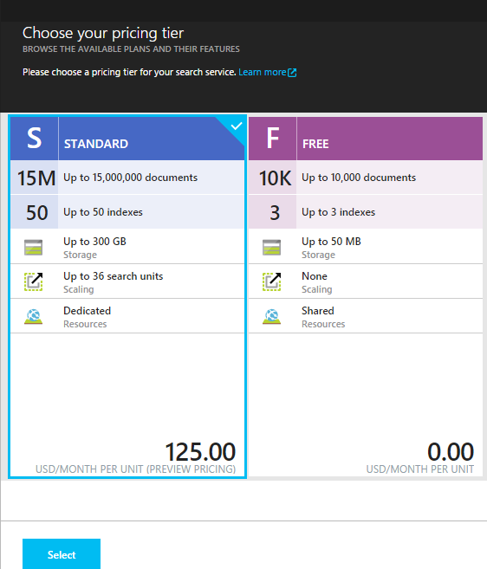
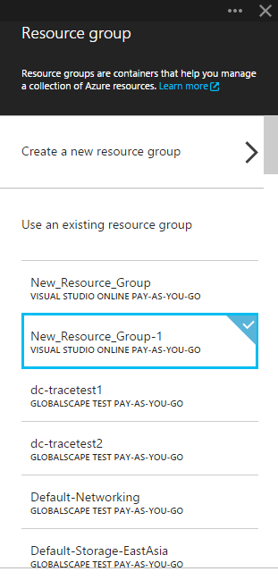
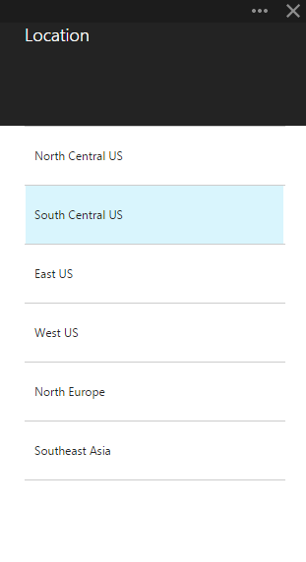
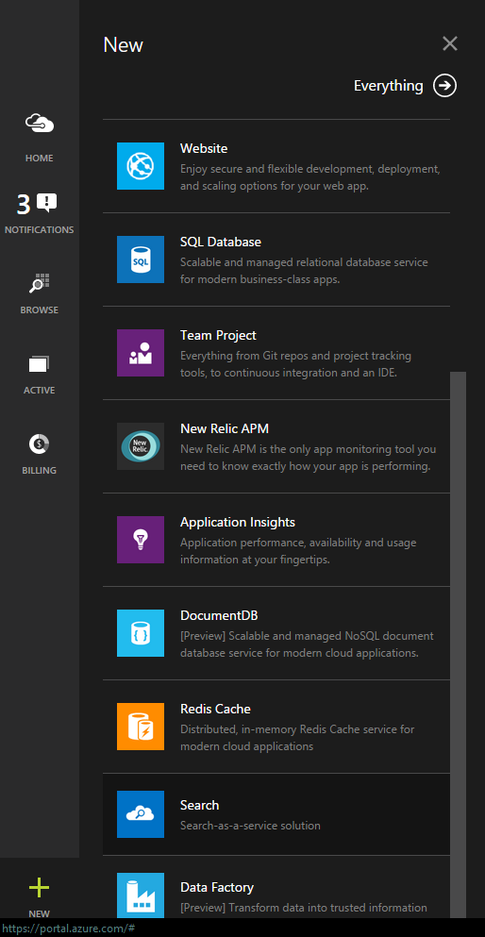
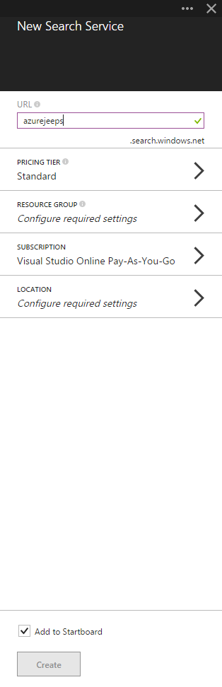
Setting up Azure Search

Slide 67
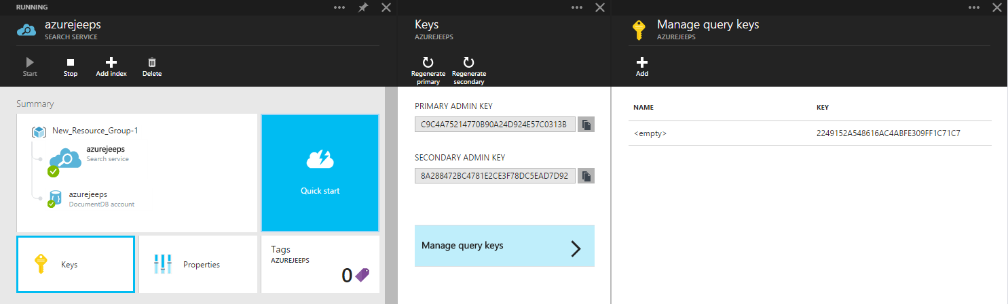
Keys

Slide 68
Azure Search Options
“Standard” can be scaled based on workload
“Free” is free and solely for testing (no perf guarantees)
REST API access only – no SDK from Microsoft yet
RedDog.Search is available on Nuget
Security is limited to API key

Slide 69
Quick specs
What | Free | Standard
Size | 50mb | 25gb per unit
Queries per second | N/A | 15 per unit
Number of documents | 10,000 across 3 indexes | 15M per unit, 50 index limit
Scale out limits | N/A | Up to 36 units
Price | Free | $.168/hour, $125/month

Slide 70
Understanding “units”
More replicas equals more performance
More partitions equals more documents and more space
1 replica + 1 partition = 1 search unit
6 replicas + 1 partition = (1 replica & 1 partition) + 5 replicas = 6 search units
2 replicas + 2 partitions = (1 replica & 1 partition) + (1 replica & 1 partition) = 2 search units

Slide 71
No SDK yet!
RedDog.Search
Provided via Nuget and on GitHub
Also all asynchronous
AdventureWorksCatalog – sample code
Great example of composing REST requests
http://azure.microsoft.com/en-us/documentation/articles/search-create-first-solution/

Slide 72
Azure Search is structured
A search index has a predefined structure
It is not dynamic
Each field in the index has characteristics defined when created
Filterable?
Searchable?
Faceted?
Retrievable?
Sortable?

Slide 73
Field Characteristics: Key
Required!
Can only be on one field for the document
Can be used to look up a document directly
Update
Delete

Slide 74
Field Characteristics: Searchable
Makes the field full-text-search-able
Breaks the words of the field for indexing purposes
“Big Red Jeep” will become separate components
A search for “big”, “red”, “jeep”, or “big jeep” will hit this record
Other field types are not searchable!
Searchable fields cause bloat!
Only make it searchable if it needs to be

Slide 75
Field Characteristics: Filterable
Doesn’t under go word breaking
Exact matches only
Only searches for “big red jeep”
will hit a “big red jeep” record
won’t hit “big jeep” record
All fields are filterable by default

Slide 76
Field Characteristics: Sortable
By default, results are sorted by score
Strings are not sortable!
All other types are sortable by default

Slide 77
Field Characteristics: Facetable
Geography points are not facetable
All other fields are facetable by default
Used to rank records by other notions
Jeeps that sold by this {dealer}
Jeeps that are this {color}

Slide 78
Field Characteristics: Suggestions
Used for auto-complete
Only for string or collection of string
False by default
Causes bloat in the index!

Slide 79
Field Characteristics: Retrievable
Allows the field to be returned in the search results
Key fields must be retrievable

Slide 80
Field Characteristics: can be false
If turning a feature on expands the index…
only turn it one when you intend to use it!
"filterable": false, "sortable": false, "facetable": false, "suggestions": false

Slide 81
Creating an index
var newIndex = new Index(Keys.ListingsServiceIndexName)
.WithStringField("Id", opt => opt.IsKey().IsRetrievable())
.WithStringField("Color", opt => opt.IsSearchable()
.IsSortable()
.IsFilterable()
.IsRetrievable()
.IsFacetable())
.WithStringField("Package", opt => opt.IsSearchable()
.IsFilterable()
.IsRetrievable()
.IsFacetable())
...
index = await managementClient.CreateIndexAsync(newIndex);

Slide 82
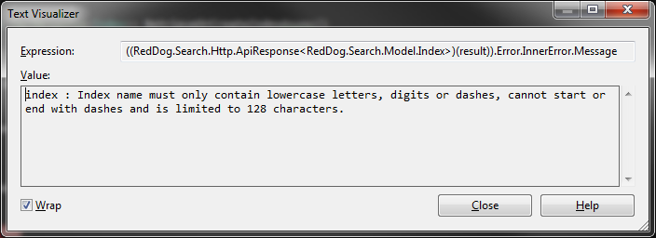
Index naming
Important!
…index names must be all lower case, digits, or dashes – 128 character max

Slide 83
Scoring Profiles
Gives you greater control over the results
Control over boosting documents based on freshness
Distance allows you to boost documents that are “closer”
Based on geographic location
Magnitude scoring alters ranking based on a range of values
Highest rated
Produces the highest margin

Slide 84
Interpolations
Slope at which boosting increases from range start to end
Linear – constant decreasing amount
Default
Constant – constant boost is applied
Quadratic – slow to fast boost drop off
Logarithmic – fast to slow boost drop off
Notes:
Added to scoring profiles

Slide 85
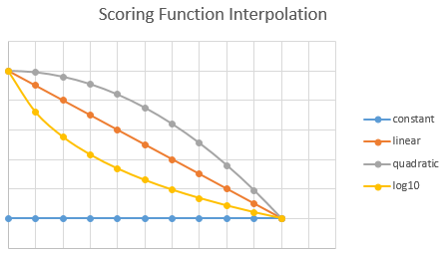
Interpolations

Slide 86
Adding a scoring profile
Can be added to the index at any time
var sp = new ScoringProfile();
sp.Name = "ByTypeAndPackage";
sp.Text = new ScoringProfileText();
sp.Text.Weights = new Dictionary<string, double>();
sp.Text.Weights.Add("Type", 1.5);
sp.Text.Weights.Add("Package", 1.5);
newIndex.ScoringProfiles.Add(sp);

Slide 87
Adding data to the index
Need to map your object to your index
var op = new IndexOperation(IndexOperationType.Upload, "Id", l.Id.ToString())
.WithProperty("Color", l.Color)
.WithProperty("Options", flatOptions)
.WithProperty("Package", l.Package)
.WithProperty("Type", l.Type)
.WithProperty("Image", l.Image);
operations.Add(op);
var result = await managementClient.PopulateAsync(Keys.ListingsServiceIndexName, operations.ToArray());

Slide 88
Batch operations
The previous code was a batch operation
You can batch up to 1000 “operations” in one call
Can be any operation in the batch
Adds
Deletes
Updates

Slide 89
Querying the index
Have to specify what fields you want returned
Can only output retrievable fields
var conn = ApiConnection.Create(Keys.ListingsServiceUrl, Keys.ListingsServiceKey);
var queryClient = new IndexQueryClient(conn);
var query = new SearchQuery(search)
.Count(true)
.Select("Id,Color,Options,Type,Package,Image")
.OrderBy("Color");
var searchResults = await queryClient.SearchAsync(Keys.ListingsServiceIndexName, query);

Slide 90
Questions on Azure Search?

Slide 91
Where might I use them?

Slide 92

Where does it fit?
NOSQL
SEARCH

Slide 93
Where does it fit?
Saga persistence
Denormalized view data
CQRS Event Store
NOSQL
SEARCH

Slide 94
Where does it fit?
Data/Decision enrichment
Search first navigation
NOSQL
SEARCH

Slide 95
Any questions on where they fit?

Slide 96
Questions?
Andrew Siemer
Clear Measure
andrew@clear-measure.com
(512) 387-1976
@asiemer
Code and slides: https://github.com/asiemer/AzureJeeps
You can find me here:
http://www.andrewsiemer.com
http://www.siemerforhire.com
http://about.me/AndrewSiemer
AzureAustin
http://www.meetup.com/AzureAustin

